Slide 1
TEAM 11
MSc DATA SCIENCE
CHIRAG AGGARWAL
THRIJWAL K
SHANKARA NARAYANA N G
VIAN DSOUZA

Slide 2
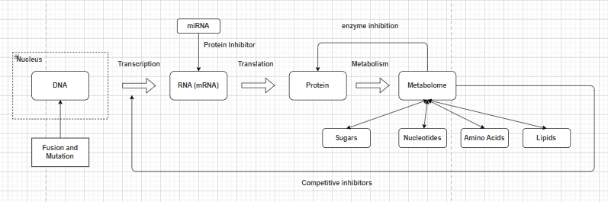
HOW IS A CELL LINE SELECTED?
A gene originates in DNA and is transcribed into mRNA, then translated into protein a cell line is selected only if evidence of this active journey is confirmed at both the RNA and protein layer, since either step can be silenced before the gene becomes functional
The metabolome reflects the combined output of all active genes and pathways two cell lines expressing the same gene can behave very differently if their underlying metabolic states differ, making metabolic similarity a critical factor in identifying truly equivalent cell lines.
Expression at one biological layer does not guarantee function at the next which is why cell line selection requires evidence across multiple layers rather than relying on any single measurement alone

Slide 3
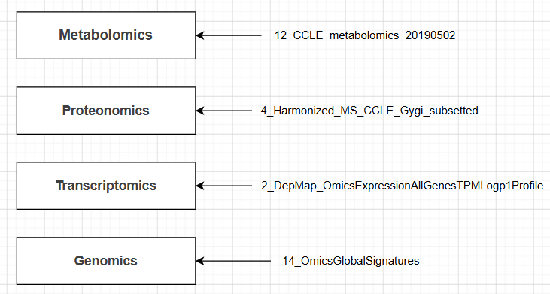
HOW ARE WE USING THE DATA ?
Slno | Validation and combining Datasets
1 | hpa_rna_celline
2 | GEOexpression
3 | OmicsFusionFilteredSupplementary
4 | OmicsSomaticMutationsProfile
5 | cellosaurus
6 | DepMap_OmicsProfiles
7 | DepMap_sample_info
8 | GEOInfo
9 | hpa_rna_celline_description
Core Dataset per layer
Core datasets capture the forward biological flow across genomics, transcriptomics, proteomics, and metabolomics layers
Supporting datasets enrich, harmonise, and validate core data ensuring measurements remain consistent and comparable across sources
All datasets are joined on a common cell line identifier forming a unified data matrix where each row is a cell line and each column is an omics feature

Slide 4


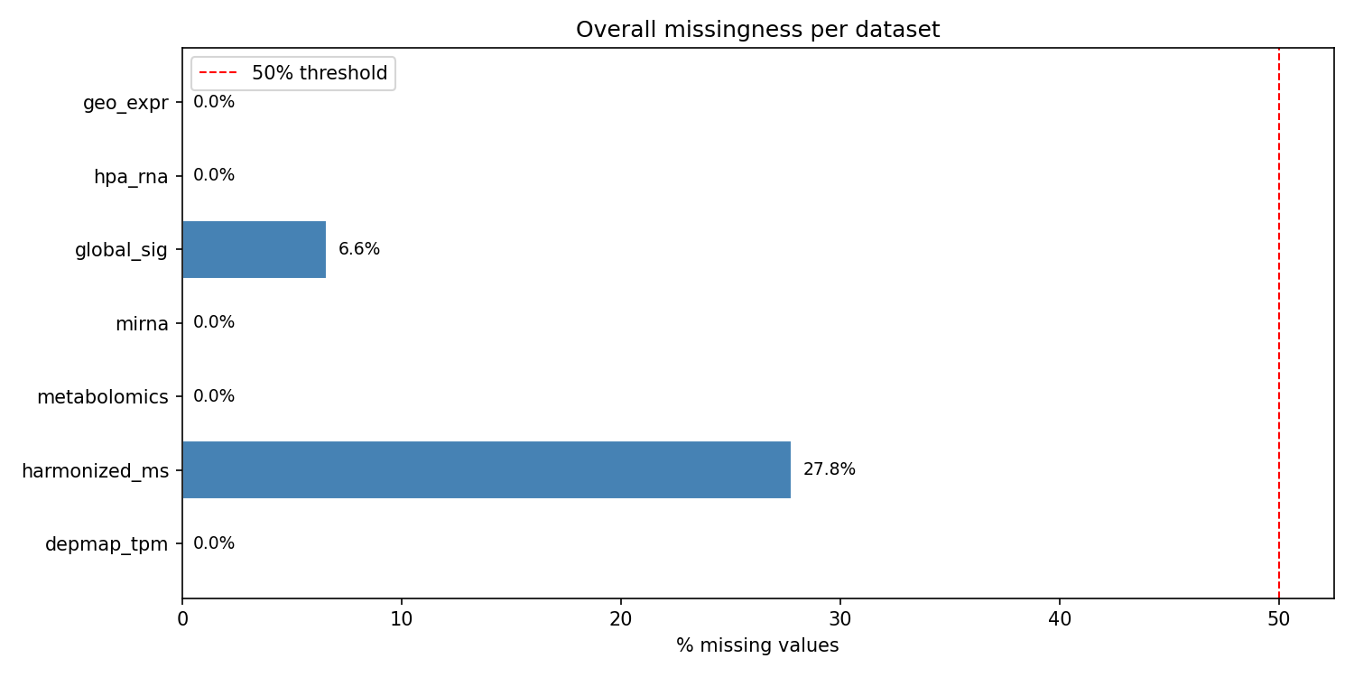

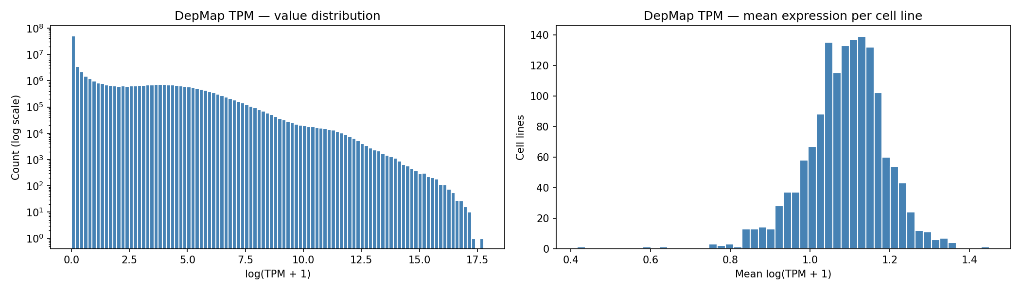
WHAT DID WE FIND IN THE DATA?
Every dataset checked for shape, distributions, missing values and duplicates across all sources
Most datasets are individually complete (DepMap RNA, HPA, metabolomics, miRNA, GEO all ~0%); global signatures 6.6%; proteomics highest at 27.8%; all below the 50% usability threshold.
DepMap RNA covers all 1,479 cell lines, HPA 1,066, metabolomics 911, and proteomics only 369; so the layers overlap only partially therefore combing will increase the chances of getting higher missing values.
Deepmap Data set which expressed the RNA values is given by log(TPM+1) which is the standard format to use instead of the raw TPM expression
16 duplicate Profile IDs resolved to 1,479 unique cell lines; identifiers harmonised across sources (~97% mapped, 41 unmapped).
PCA, Truncated SVD were applied and visualised to check for structure in the integrated multi-omics data.

Slide 5
CHALLENGES SO FAR AND HOW ARE WE ADDRESSING THEM
Data Heterogeneity across Sources
  RNA → logarithmic values
  Proteomics & Metabolomics → normalized values
  Global Signatures → genomic metrics on different scales
  To overcome → StandardScaler (z-score) for PCA; MinMaxScaler [0,1] for main pipeline
Gene Name & ID Mapping
  Some columns had only ENSG IDs with no associated gene names
  22 genes missing → BioMart export resolved 12
  Gene-to-protein mapping table built to link RNA data to proteomics
Profile ID Duplication in RNA Base Table
  16 duplicates found across 1,495 Profile IDs
  Kept first entry per cell line → 1,479 unique cell lines

Slide 6
Cell Line Name ↔ Model ID Matching
  Cross-reference column in Cellosaurus table used
  ~97% resolved | 41 cell lines remain unmapped
  Master Lookup Table created → used for all dataset merges
ACH ID | PR ID | CVCL ID | CCLE Name | Cell line name | Stripped cell line name | Primary disease | Lineage | Unmapped
ACH-000520 | PR-09gmEI | CVCL_2291 | 59M_OVARY | 59M | 59M | Ovarian Cancer | ovary | FALSE
ACH-000575 | PR-0B6q0Z | CVCL_5134 | HCC364_LUNG | HCC364 | HCC364 | Lung Cancer | lung | FALSE
ACH-000856 | PR-0f2vAo | CVCL_1110 | CAL51_BREAST | CAL-51 | CAL51 | Breast Cancer | breast | FALSE
ACH-001335 | PR-0fum2y | CVCL_1095 | C4II_CERVIX | C-4 II | C4II | Cervical Cancer | cervix | FALSE
ACH-000411 | PR-0hvX2B | CVCL_1050 | 769P_KIDNEY | 769-P | 769P | Kidney Cancer | kidney | FALSE
ACH-000414 | PR-0jK5CP | CVCL_1508 | NCIH1944_LUNG | NCI-H1944 | NCIH1944 | Lung Cancer | lung | FALSE
Missing Data across Modalities
  75% of cell lines: no proteomics data
  38% of cell lines: no metabolomics data
  31% of cell lines: no HPA RNA data

Slide 7
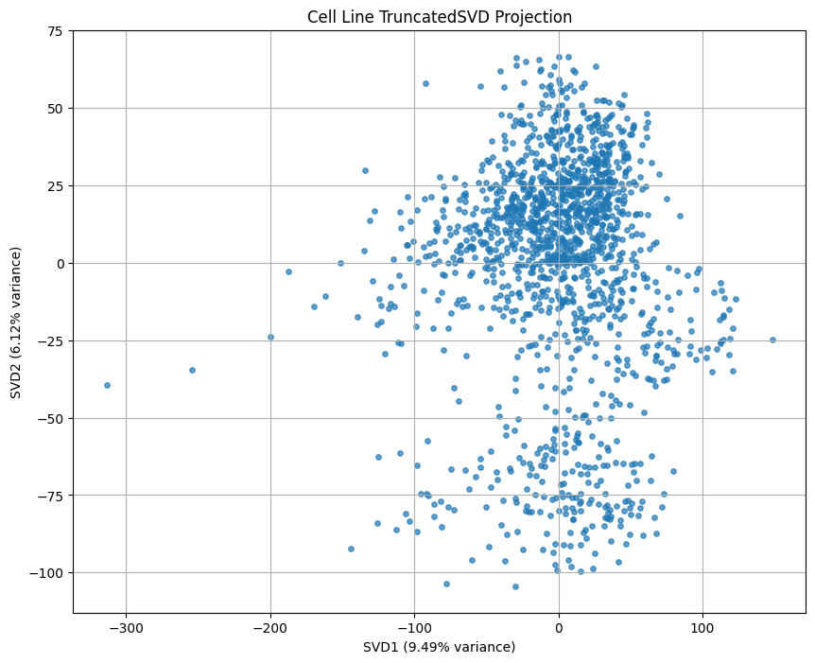
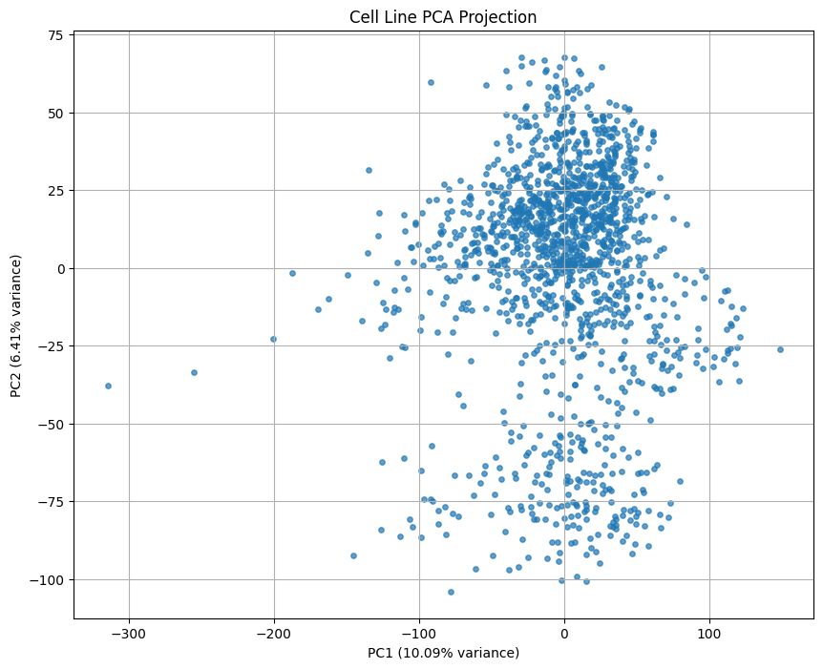
PCA on the Data
PCA and Trucated SVD were heavily dominated by the missing data.

Slide 8
Balancing automation with biological interpretability
Initial exploration included LLM based approaches for ranking cell lines however, LLMs introduce hallucination risk and lack transparent, auditable reasoning over quantitative biological data
Trying to find a statistical approach for ranking the cell lines (based on predetermined scoring) to preserve the logic and biological meaning

